Slide 1
Educational Measurement and Item Development
An Introductory Workshop
Dr Nathanael Reinertsen
Directorate for Education and Skills
24 October 2024

Slide 2
Workshop Overview
Day 1
What is educational measurement?
Day 2
Item Development Principles
Day 3
Item evaluation (with Rasch Measurement, and Item-Response Theory)
Day 4
Test construction and test evaluation
Day 5
Cognitive Walkthroughs in Item Development

Slide 3
Day 4 Outline
Test Construction and Evaluation
Session 1
Item Banks and Test Construction
Session 2
Test Equating
Session 3
Introduction to Cognitive Walkthroughs
Session 4
Practical part 1: Preparing for Cognitive Walkthroughs

Slide 4
1
Item Banks and Test Construction

Slide 5
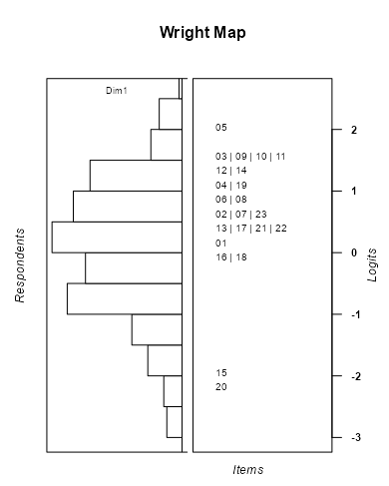
Considerations in Test Design: Targeting
If a test is too hard, or too easy, for most students then:
Students may disengage
Students may get few items correct (or incorrect)
Measurement becomes less accurate/reliable (more on that in session 3).
We need to be able to ‘see’ what students can and can’t do, to make reliable judgments about them.

Slide 6
Item pools and test forms
Items 1-20
Link Items
Items 20-40
Items 40-60
Test Form 1 (Items 1-40)
Test Form 2 (Items 20-60)
Easy
Hard
Variable

Slide 7
Warm-up discussion
What are the reasons for needing/wanting a big item bank?

Slide 8
Rotational designs
Each student will only see a portion of the items
Each unit/cluster/block, appears once in each position (1st, 2nd, 3rd)
Booklet 1 | Booklet 2 | Booklet 3 | Booklet 4 | Booklet 5 | Booklet 6 | Booklet 7 | Booklet 8 | Booklet 9 | Booklet 10 | Booklet 11 | Booklet 12
M1 | S1 | R1 | M2 | S2 | R3 | M3 | S3 | R4 | M4 | S4 | R2
R2 | M1 | S1 | R1 | M2 | S2 | R3 | M3 | S3 | R4 | M4 | S4
S4 | R2 | M1 | S1 | R1 | M2 | S2 | R3 | M3 | S3 | R4 | M4

Slide 9
If individual measurement is not needed…
Booklet 1 | Booklet 2 | Booklet 3 | Booklet 4 | Booklet 5 | Booklet 6 | Booklet 7 | Booklet 8 | Booklet 9 | Booklet 10 | Booklet 11 | Booklet 12
M1 | S1 | R2 | M2 | S2 | R3 | M3 | S3 | R4 | M4 | S4 | R1
R1 | M1 | S1 | R2 | M2 | S2 | R3 | M3 | S3 | R4 | M4 | S4

Slide 10
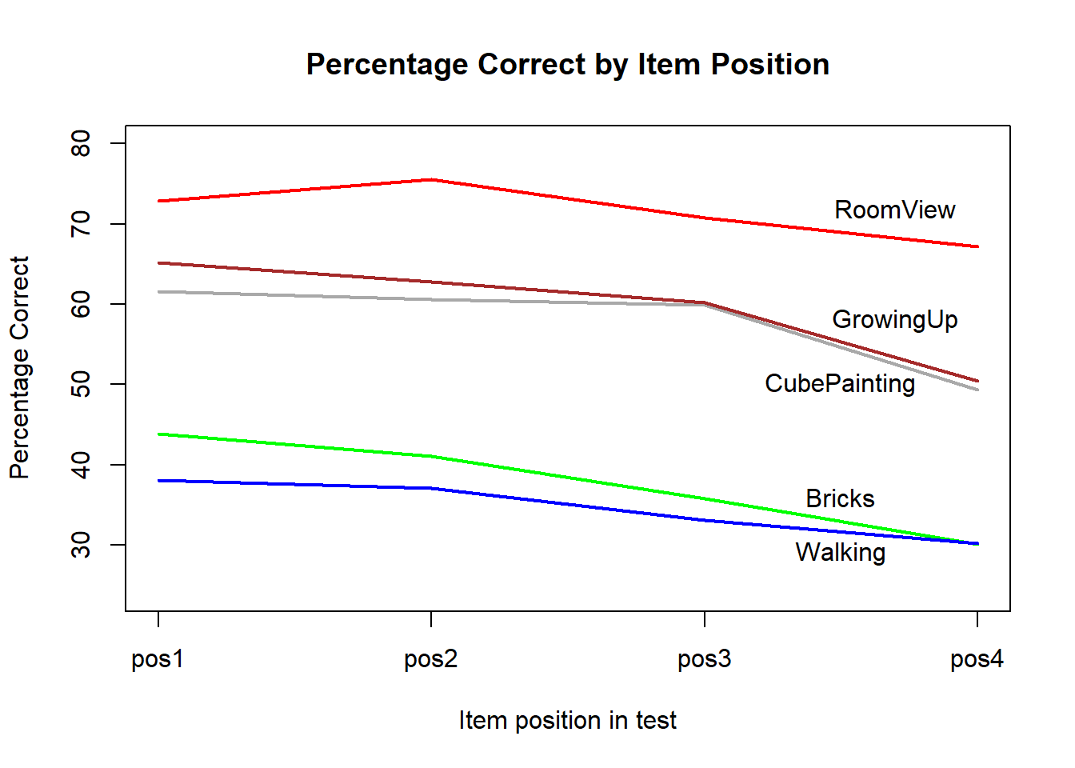
Discussion
PISA 2003 used a rotated test booklet design.
Each test booklet was divided into four sections. Each item appeared in four test booklets, once in each of the four sections.
The CTT facility of five maths items are shown to the right.
What’s the best hypothesis to explain what’s happening?
Notes:
Chapter 9 Equating Tests. Part 2: Practice | A Course on Test and Item Analyses (edmeasurementsurveys.com)
It has been observed that the position of the placement of an item in a test affects the item’s difficulty. An item placed at the beginning of a test appears to be easier than the same item placed at the end of a test. We will call this the fatigue effect. This effect has been observed in the PISA tests. In PISA 2003, test items were placed according to a rotated test booklet design. Each test booklet was divided into four sections. Each item appeared in four test booklets, in each of the four sections. The test booklets were randomly distributed to students, so it could be assumed that the average ability of students taking each booklet was the same across all booklets.
The following shows five PISA 2003 mathematics items, and the percentages correct when the items were placed in each of the four sections of a test.

Slide 11
Considerations in Test Design: Order Effects
Other types of order effects
Practice effects – multiple items in a form that test the same skill in the same way
Overlapping content – Content/topics being covered in different units
Any others?
What strategies can you think of in test design and construction to mitigate these effects?
Notes:
Mitigation strategies:
Careful review at the item, unit and test form stages
Keeping track of ‘Enemy items’

Slide 12
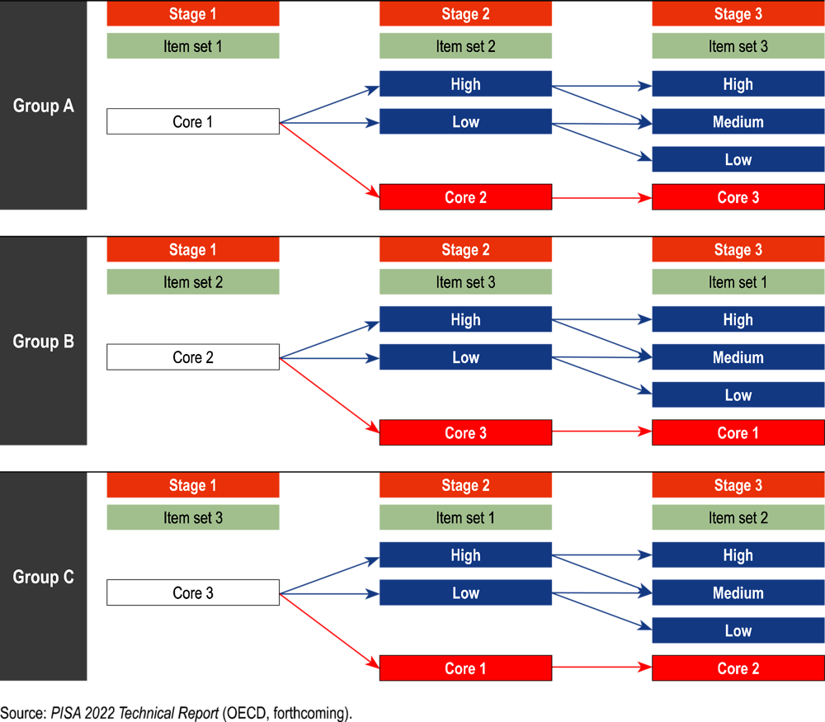
Computer Adaptive Testing
Notes:
This is the “standard design”, that was administered to 75% of computer-based test-takers in PISA Reading 2022. The “alternative” swapped Stage 2 and Stage 1 (presumably to estimate/control order effects).

Slide 13
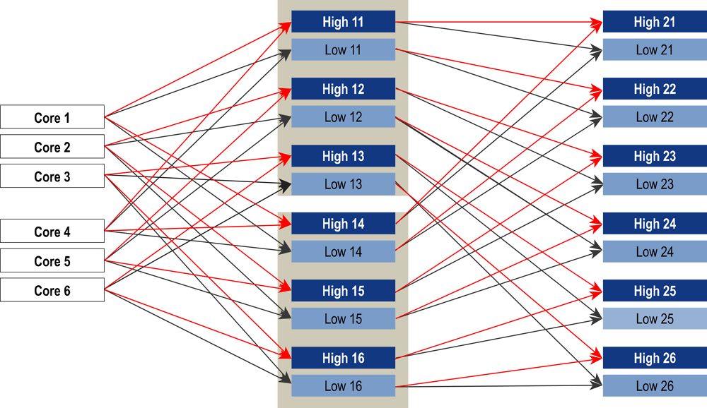
Computer Adaptive Testing
30 testlets, 48 paths

Slide 14
2
Test Equating

Slide 15
Why do we need to equate tests?
When we calibrate test data, the 0-point (origin) of our variable is arbitrary.
We, customarily, set 0 logits to be the average difficulty of all the items we are calibrating.
If we do separate calibrations of separate test forms, we don’t know if 0 on one test is equal to 0 on the other: there is no external reference point to compare to.

Slide 16
Linking designs
To put the items from two test forms on the same variable, we need something in common.
Common-items: where a sub-set of items is in both tests
Common persons: where two tests are administered to the same sample of people, under the same conditions.
Which do you think is more common? Why?

Slide 17
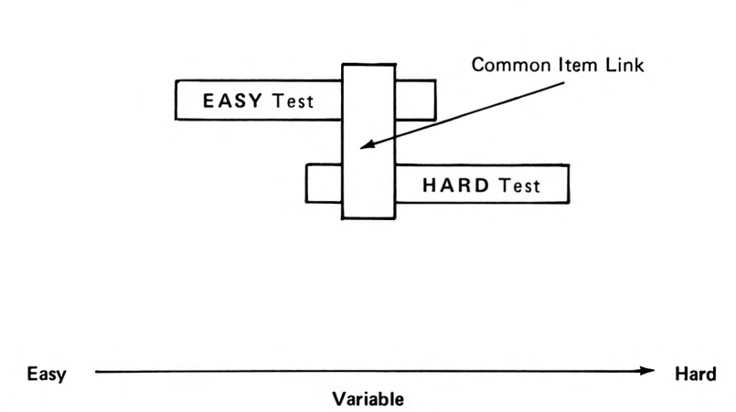
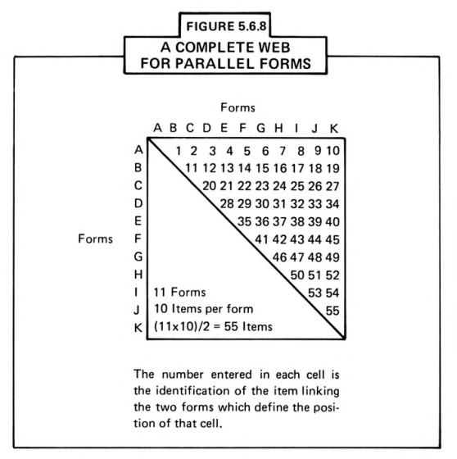
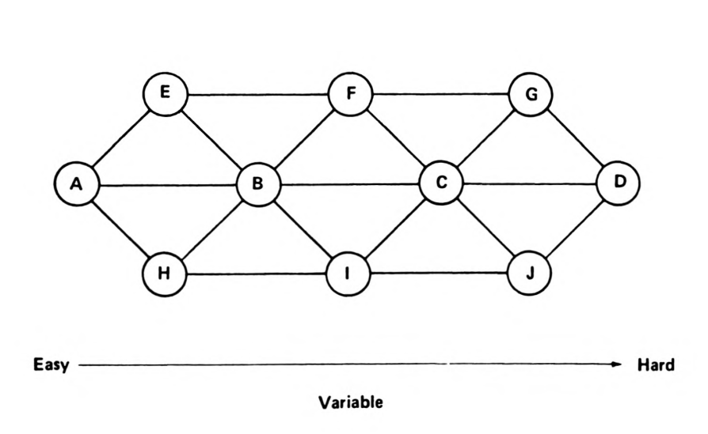
Common-item designs, from simple to complex

Slide 18
Concurrent calibration
If we have linked test forms, that were administered
about the same time, and
to similar students,
then we can use the whole data set for calibration.
Not all students took all items, so there will be missing data.
That’s not a problem for Rasch or IRT models.
If we administered the tests at very different times, to completely different students (e.g. PISA cycles), we need other methods.

Slide 19
Shift Method
Assume we gave a test last year, and a new one this year.
There is a 50% overlap of items (i.e. this year we had 50% new items).
We did separate calibrations, so we have a set of item parameters from last year and a set from this year.
To put the new items on the old scale:
calculate the mean difficulty of the common items at Time 1
calculate the mean difficulty of the common items at Time 2
add the difference to all items administered at Time 2.

Slide 20
Example
Test 2023 |  | Test 2024 |  | Test 2024 on 2023 scale
1 | 0.79 | 1 | 0.85 | 1
2 | 0.50 | 2 | 0.63 | 2
3 | 0.51 | 3 | 0.64 | 3
4 | 1.72 | 4 | 1.90 | 4
5 | 0.96 | 5 | 1.11 | 5
6 | 1.12 | 6 | 1.25 | 6
7 | 1.08 | 7 | 1.18 | 7
8 | 1.24 | 8 | 1.29 | 8
9 | 0.85 | 9 | 0.94 | 9
10 | 1.07 | 10 | 1.16 | 10
11 | 0.75 | 21 | 0.67 | 21
12 | 1.34 | 22 | 1.25 | 22
13 | 0.22 | 23 | 1.25 | 23
14 | 0.43 | 24 | 1.75 | 24
15 | 1.29 | 25 | 1.45 | 25
16 | 1.36 | 26 | 1.34 | 26
17 | 0.90 | 27 | 1.04 | 27
18 | 0.81 | 28 | 0.52 | 28
19 | 1.90 | 29 | 0.94 | 29
20 | 1.44 | 30 | 0.90 | 30
To put the 2024 items on the 2023 scale:
calculate the mean difficulty of the common items in 2023
calculate the mean difficulty of the common items in 2024
add the difference to all items administered in 2024

Slide 21
Example
Test 2023 |  |  | Test 2024 |  |  |  | Test 2024 on 2023 scale
1 | 0.79 |  | 1 | 0.85 |  |  | 1 | 0.73
2 | 0.50 |  | 2 | 0.63 |  |  | 2 | 0.50
3 | 0.51 |  | 3 | 0.64 |  |  | 3 | 0.52
4 | 1.72 | Mean Old: | 4 | 1.90 | Mean New: |  | 4 | 1.77
5 | 0.96 | 0.98 | 5 | 1.11 | 1.10 |  | 5 | 0.98
6 | 1.12 |  | 6 | 1.25 |  | Difference in means: | 6 | 1.13
7 | 1.08 |  | 7 | 1.18 |  | -0.12 | 7 | 1.06
8 | 1.24 |  | 8 | 1.29 |  |  | 8 | 1.17
9 | 0.85 |  | 9 | 0.94 |  |  | 9 | 0.82
10 | 1.07 |  | 10 | 1.16 |  |  | 10 | 1.04
11 | 0.75 |  | 21 | 0.67 |  |  | 21 | 0.55
12 | 1.34 |  | 22 | 1.25 |  |  | 22 | 1.12
13 | 0.22 |  | 23 | 1.25 |  |  | 23 | 1.13
14 | 0.43 |  | 24 | 1.75 |  |  | 24 | 1.62
15 | 1.29 |  | 25 | 1.45 |  |  | 25 | 1.32
16 | 1.36 |  | 26 | 1.34 |  |  | 26 | 1.21
17 | 0.90 |  | 27 | 1.04 |  |  | 27 | 0.92
18 | 0.81 |  | 28 | 0.52 |  |  | 28 | 0.40
19 | 1.90 |  | 29 | 0.94 |  |  | 29 | 0.81
20 | 1.44 |  | 30 | 0.90 |  |  | 30 | 0.77
Mean of common items in 2024 is now 0.97

Slide 22

Shift and scale Method
What if we check the spread of scores of common items on the two tests, and we find the standard deviation is different?
We can deal with that, too:

Slide 23
Item invariance
Why would we expect the parameters to be stable?
If we saw big changes, we would ‘break’ the link.
We could exclude the item altogether, or just allow it to have different parameters at Time 1 and Time 2.

Slide 24
Anchoring Method
Because we don’t expect parameters to change a lot, we can also just use the Time 1 parameters for the common items when we calibrate Time 2.
This is done in Rasch/IRT software.
In practice, a linking error is also calculated and applied in estimates of standard errors. This quantifies how much variance there was in item parameters (even though the expectation is that it’s very small).

Slide 25
3
Introduction to Cognitive Walkthroughs

Slide 26
Item Development Overview
Drafting
Item writing
Internal Review
Cognitive Walkthroughs
External Review
Expert Review Groups
Field Trial
Psychometric review
Gather response data
Fit model(s); check item functioning
(a.k.a. ‘panels’)

Slide 27
Cognitive Walkthroughs 1: Preparation
Independent review of all units, before the CW.
Each person should make notes on all items and stimulus for:
Suitability of the content for the level of the target test candidates
Suitability of the content for the context/s of the target test candidates
Alignment of the item to the assessment framework
Accuracy of the key
Quality and ordering of the distractors
Accuracy of spelling, grammar, vocabulary, technical terms and general expression.
Notes should offer alternatives and solutions, not just point out problems.

Slide 28
Cognitive Walkthroughs 2: Procedure
The Test Development Manager (TDM) chairs the panel, but delegates to each Test Developer (TD) the chairing of the discussion for their own unit
The discussion should review (in order):
any relevant points about the stimulus
each item
All suggested edits must be agreed to by consensus
The TD who developed the unit takes notes about required edits.
Other TDs are encouraged to share any written notes they have made.
After a unit has been discussed, the TDM should determine whether the unit, given the edits to be made and the prior discussion, should be panelled again at future time or finalised by the TD.
The TDM should then invite the next TD to run the discussion on their unit.

Slide 29
Cognitive walkthroughs are emotionally difficult
You know that…
your fellow TDs are not your enemies; they are colleagues
your fellow TDs are expert critics that will improve your work
your fellow TDs are judging the unit, not you!
However…
you will feel judged
you will feel an impulse to react defensively by:
giving in / giving up / going quiet
getting angry or frustrated

Slide 30
Critical distance ‘under the spotlight’
Things to try to remember when your unit is under review:
You are not your work.
Try hard to keep in mind that all critiques are about the unit, not you.
They are not judgments about you or your intelligence, experience, capacity, etc.
It is OK to tell the group, at any point:
“I’m finding this hard. Can we take a break?”
“Can we look at another unit and come back to this one later?”

Slide 31
Critical distance as a reviewer
When you are discussing or critiquing another TD’s unit:
All your comments and questions must be directed to the whole group
Directing your questions directly to the unit writer can feel like an interrogation
Use ‘soft’ questions, inviting everyone to discuss
If you see a problem, offer a solution. That means being well-prepared!!!

Slide 32
Framing
Suggestions for giving inclusive, respectful feedback
Don’t be confrontational
Be collaborative
This is too hard for any 15-year-old.
C and D are a pair; that’s going to cause problems.
Only well-off city kids will relate to the issues in this reading passage.
I’m worried that this might be too hard for the average 15-year-old. What do you all think?
Options C and D both start with the word ‘consider’, so what do you all think about changing D to start with ‘think about’?
I was wondering about the readers who will be able to relate to this stimulus. What sorts of people do you all think they might be?

Slide 33
Be kind to each other
Even with colleagues you trust, who are being as inclusive as possible in their feedback, be prepared to feel judged.
Acknowledge your emotions; they are normal.
Ask for a break if you need it.
Be aware of how the unit writer is reacting to the discussion and feedback.
Don’t wait for them to ask for a break: if you think they might need one, offer one.

Slide 34
4
Practical part 1: Preparing for Cognitive Walkthroughs

Slide 35
Mental checklist
Suitability of the content for the level of the target test candidates
Suitability of the content for the context/s of the target test candidates
Content overlap in items
Alignment of the item to the assessment framework
Correct framework variables (cognitive process, item intent, etc.)
Accuracy of the key
Quality and ordering of the distractors
Accuracy of spelling, grammar, vocabulary, technical terms and general expression.
Remember: Have suggested changes already written!

